Slide 1

POWER BI – Financial Data
Analysis
Presented by: MD. FAISAL PASHA
Batch No: 435
INNOMATICS RESEARCH LABS
DILSUKHNAGAR

Slide 2

Introduction:
Financial statements contain valuable information about a company’s performance and financial health
Analyzing income statements, balance sheets, and cash flow statements together provides deeper insights.
Power BI enables interactive analysis and visualization of complex financial data.
This project focuses on transforming raw financial data into meaningful business insights.

Slide 3

Problem Statement:
Financial data is often scattered across multiple datasets and time periods
Manual analysis makes it difficult to track trends
and compare companies efficiently.
Identifying profitability, liquidity, and leverage
patterns can be time-consuming
There is a need for a centralized and interactive financial analysis solution

Slide 4

Objective:
Analyze financial performance of multiple companies.
Compare revenue, net income, cash flow, assets, and liabilities.
Identify trends across annual and quarterly periods.
Evaluate company profitability, liquidity, and financial stability.
Develop interactive dashboards using Power BI.
Support data-driven decision-making.

Slide 5
Dataset Description:
The project uses financial statement data from multiple companies.
Data is categorized into three main financial statements:
Income Statement – Revenue, costs, and profitability metrics.
Balance Sheet – Assets, liabilities, and equity information.
Cash Flow Statement – Operating, investing, and financing cash flows.
Each dataset contains:
Company identifier (Ticker).
Reporting period (Annual / Quarterly).
Financial values.
Reporting dates.
The datasets together provide a comprehensive view of company .
financial performance over time.

Slide 6

Data Cleaning:
Combined annual and quarterly datasets into unified tables.
Standardized column names and data formats across all datasets.
Converted date columns into proper date format.
Created a Date table to enable time-based analysis.
Removed unnecessary columns to optimize performance.
Ensured consistent relationships between:
Income Statement
Balance Sheet
Cash Flow Statement
Handled missing or null values to avoid calculation errors
Verified data consistency across companies and periods

Slide 7
DAX Measures:
Created DAX measures to calculate key financial metrics
Measures were grouped into a dedicated Measures table.
Key measures include:
Total Revenue Net Income
Operating Cash Flow Free Cash Flow Total Assets and Total Liabilities
Developed financial ratios and KPIs:
Debt-to-Equity Ratio Current Ratio
Year-over-Year Growth Metrics
Implemented time intelligence functions:
Year-over-Year revenue growth Trend analysis across periods
DAX measures enabled dynamic calculations based on slicer selections

Slide 8
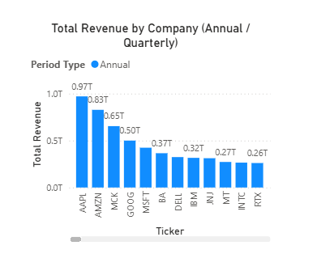
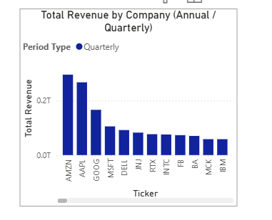
Visualizations:
What is the total revenue of each company annually and quarterly?
Insights:
Annual revenue highlights long-term company scale, while quarterly data shows short-term performance fluctuations.
Revenue levels vary significantly across companies, indicating differences in market size and business strength.

Slide 9
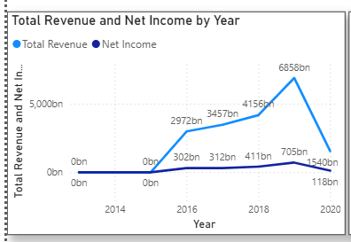
How do revenue and net income change over time across companies?
Insights:
Revenue growth does not always translate into proportional profit growth.
Some companies show improving profitability while others face margin pressure.

Slide 10
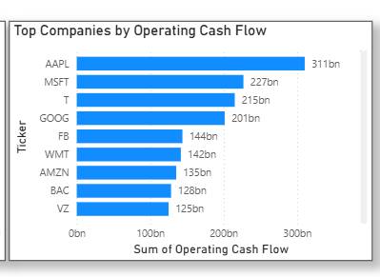
Which companies generate the highest cash flow from operations?
Insights:
A few companies consistently dominate operating cash flow generation.
Strong operating cash flow indicates sustainable core business performance.

Slide 11
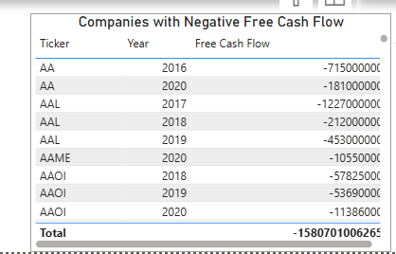
Which companies have negative free cash flow?
Insights:
Some companies are unable to cover investments through operational cash.
Persistent negative free cash flow highlights potential liquidity risks.

Slide 12
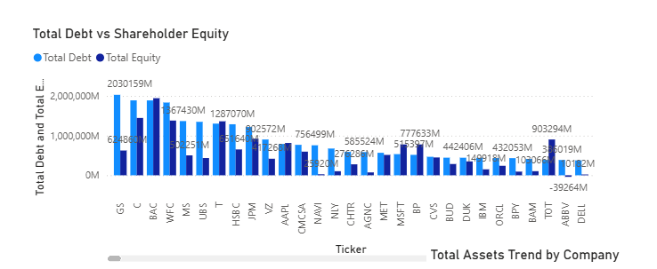
How does total debt compare to shareholder equity across companies?
Insights:
Capital structures vary significantly across companies.
Higher debt levels indicate increased financial leverage and risk.

Slide 13
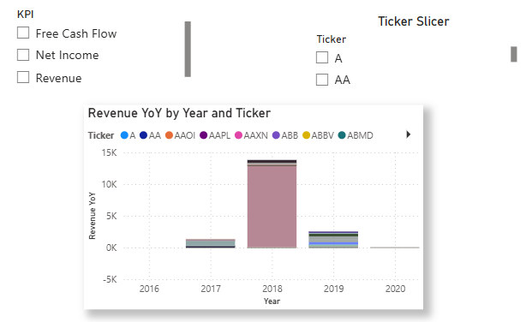
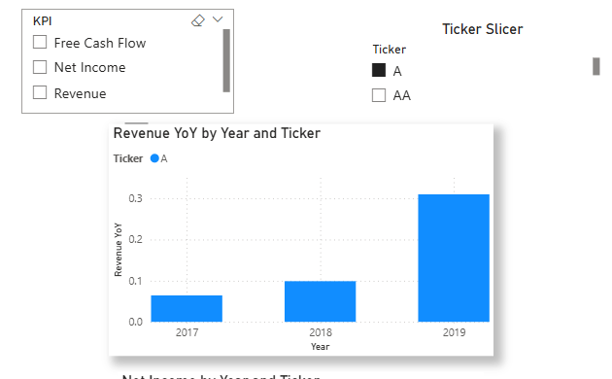
How did revenue change year over year?
Insights:
Revenue growth rates fluctuate across years and companies.
Some companies demonstrate consistent growth while others show volatility.

Slide 14
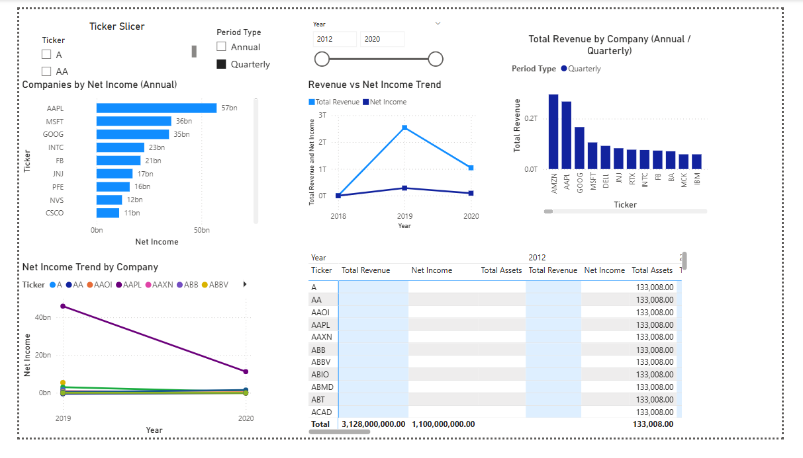

Slide 15
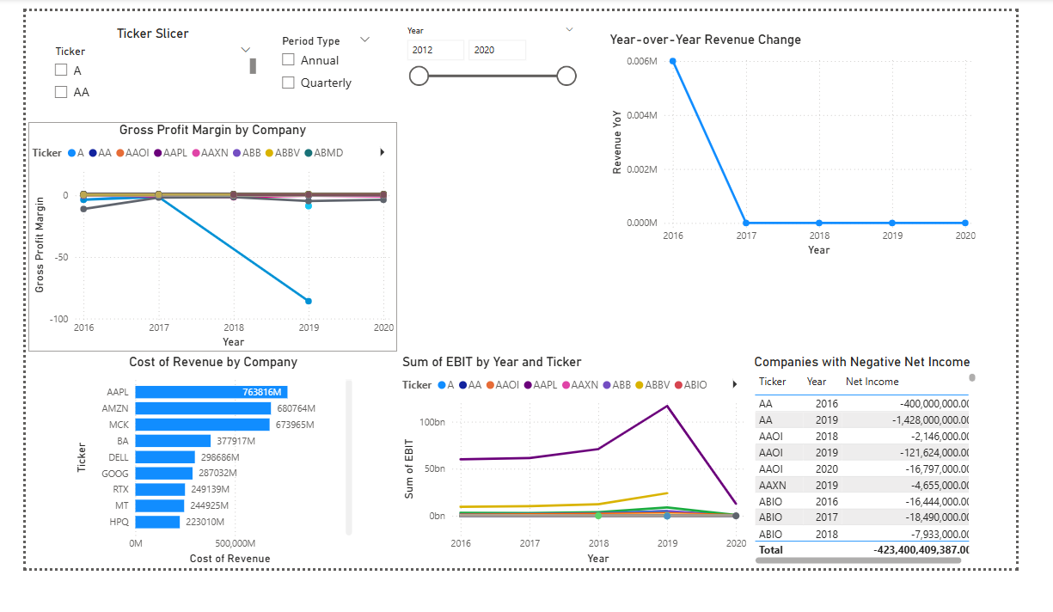

Slide 16
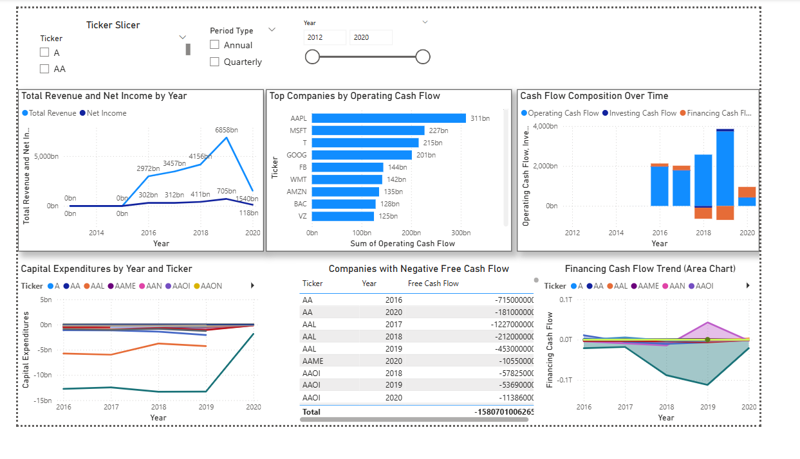

Slide 17
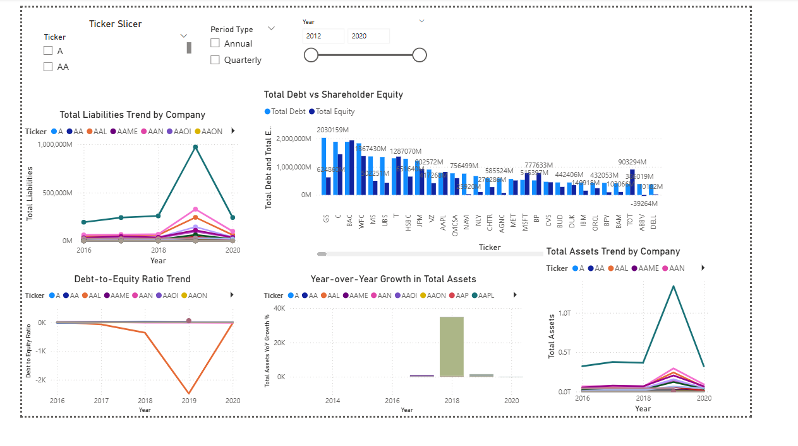

Slide 18
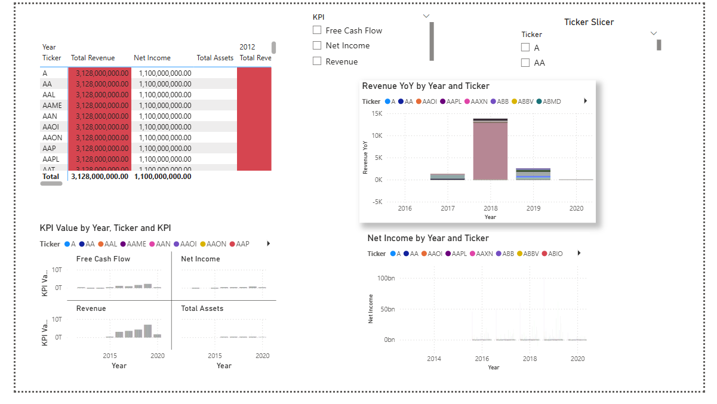

Slide 19
Conclusion:
The analysis provided a comprehensive view of company financial performance using income statement, balance sheet, and cash flow data.
Interactive Power BI dashboards enabled effective comparison of companies across annual and quarterly periods.
Key financial metrics revealed significant differences in growth, profitability, liquidity, and leverage among companies.
Cash flow analysis highlighted both financially stable companies and those facing potential liquidity risks.
The project demonstrated how data visualization and DAX-driven insights support informed, data-driven financial decision-making.

Slide 20

THANK YOU

